Slide 1
Dashboard Layout Designs
Coffee

Slide 2
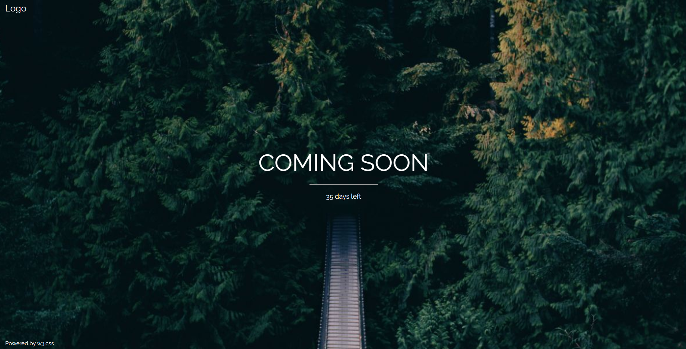

Slide 3
Robusta
add description
Arabica
add description

Slide 4
Do you prefer your coffee to be more aromatic?
Yes
No

Slide 5
Strong or Weak
Strong
Weak

Slide 6
Do you appreciate an aftertaste?
yes
no

Slide 7
How many sugars do you add to your coffee?
<2 tsp
> 2tsp

Slide 8
Here is your recommended Coffee
Lists and information maybe a hover over? or add info.

Slide 9
Dog Layout
List of dog breed it could be and pictures
Upload a picture of your dog
Info about dog 1
Upload
Info about dog 2
was this accurate? pop up?
Yes/No try again
Info about dog 3

Slide 10
Sign Language ML

